Slide 1




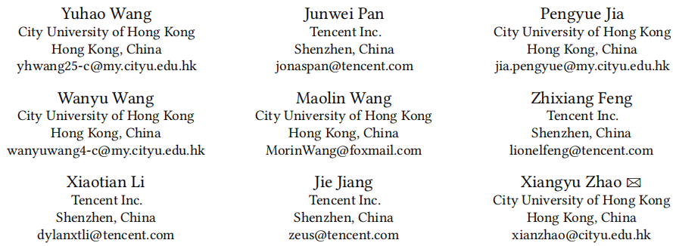





ATAI
Advanced Technique of Artificial Intelligence
ATAI
ChongqingUniversity _{AdvancedTechniqueof}
of Technology Artificial Intelligence
Chongqing University of Technology
Chongqing University ^{ATAI}
_{of Technology} Advanced Techniqueof
Artificial Intelligence
Chongqing University of Technology
Chongqing University of Technology
Pre-train, Align, and Disentangle: Empowering Sequential Recommendation with Large Language Models
code: https://github.com/Applied-Machine-Learning-Lab/PAD
—— SIGIR ’25
Reported by Junsi Chen
1

Slide 2

ATAI
AdvancedTechniqueof
Artificial Intelligence
ATAI
ChongqingUniversity _{AdvancedTechniqueof}
of Technology Artificial Intelligence
ChongqingUniversity of Technology
Motivation
(1) High Inference Latency of LLM-based Recommenders.
(2) Non-characteristic kernels fail to capture all statistical aspects of the data distribution, potentially leading to suboptimal performance.
(3) Catastrophic Forgetting in Alignment.

Slide 3

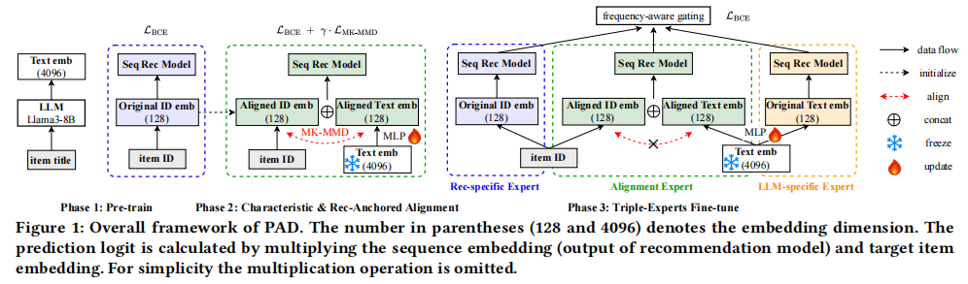
ChongqingUniversity of Technology
ATAI
AdvancedTechniqueof
Artificial Intelligence
ATAI
ChongqingUniversity _{AdvancedTechniqueof}
of Technology Artificial Intelligence
Overview

Slide 4







ChongqingUniversity of Technology
ATAI
AdvancedTechniqueof
Artificial Intelligence
ATAI
ChongqingUniversity _{AdvancedTechniqueof}
of Technology Artificial Intelligence
Method
(1)
(7)
(2)
(8)
(3)
(9)
(4)
(10)
(5)
(6)
(11)

Slide 5

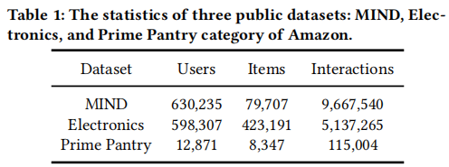
ATAI
Advanced Technique of Artificial Intelligence
ATAI
ChongqingUniversity _{AdvancedTechniqueof}
of Technology Artificial Intelligence
Chongqing University of
Technology
Chongqing University ^{ATAI}
_{of Technology} Advanced Techniqueof
Artificial Intelligence
Chongqing University of Technology
Chongqing University of Technology

Slide 6
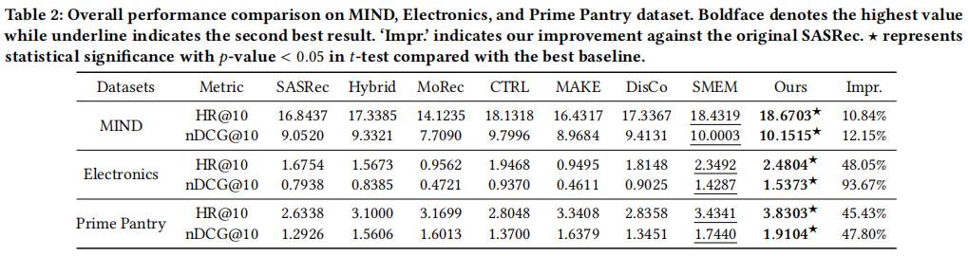
ATAI
Advanced Technique of Artificial Intelligence
ATAI
ChongqingUniversity _{AdvancedTechniqueof}
of Technology Artificial Intelligence
Chongqing University of
Technology
Chongqing University ^{ATAI}
_{of Technology} Advanced Techniqueof
Artificial Intelligence
Chongqing University of Technology
Chongqing University of Technology

Slide 7
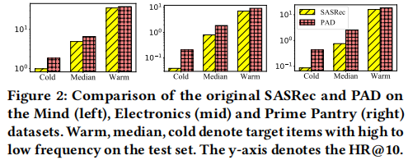
ATAI
Advanced Technique of Artificial Intelligence
ATAI
ChongqingUniversity _{AdvancedTechniqueof}
of Technology Artificial Intelligence
Chongqing University of
Technology
Chongqing University ^{ATAI}
_{of Technology} Advanced Techniqueof
Artificial Intelligence
Chongqing University of Technology
Chongqing University of Technology

Slide 8
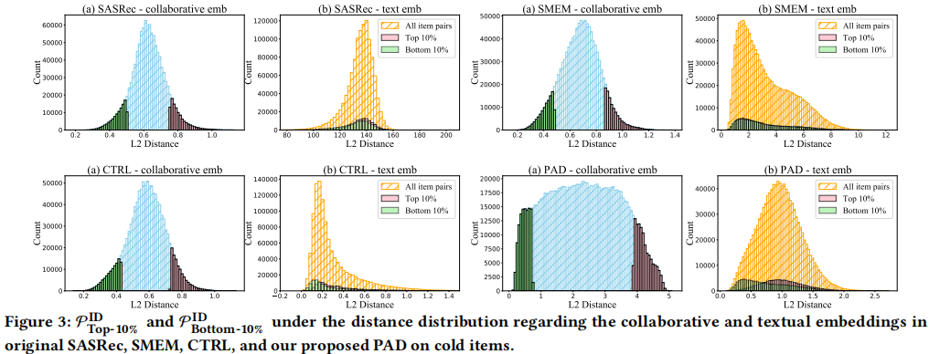
ATAI
Advanced Technique of Artificial Intelligence
ATAI
ChongqingUniversity _{AdvancedTechniqueof}
of Technology Artificial Intelligence
Chongqing University of
Technology
Chongqing University ^{ATAI}
_{of Technology} Advanced Techniqueof
Artificial Intelligence
Chongqing University of Technology
Chongqing University of Technology

Slide 9
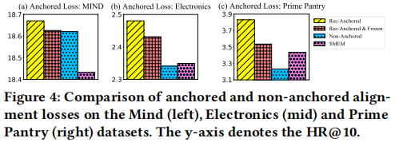
ATAI
Advanced Technique of Artificial Intelligence
ATAI
ChongqingUniversity _{AdvancedTechniqueof}
of Technology Artificial Intelligence
Chongqing University of
Technology
Chongqing University ^{ATAI}
_{of Technology} Advanced Techniqueof
Artificial Intelligence
Chongqing University of Technology
Chongqing University of Technology

Slide 10
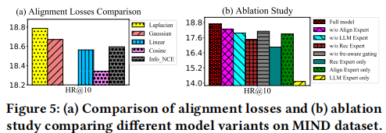
ATAI
Advanced Technique of Artificial Intelligence
ATAI
ChongqingUniversity _{AdvancedTechniqueof}
of Technology Artificial Intelligence
Chongqing University of
Technology
Chongqing University ^{ATAI}
_{of Technology} Advanced Techniqueof
Artificial Intelligence
Chongqing University of Technology
Chongqing University of Technology

Slide 11
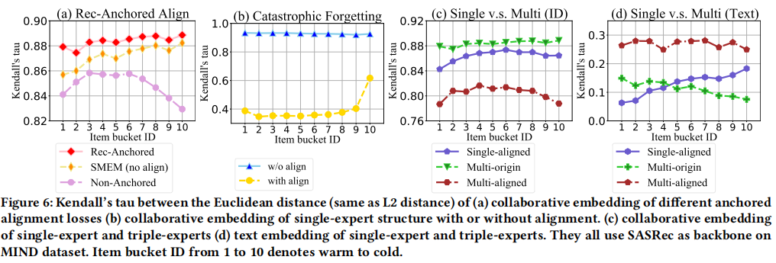
ATAI
Advanced Technique of Artificial Intelligence
ATAI
ChongqingUniversity _{AdvancedTechniqueof}
of Technology Artificial Intelligence
Chongqing University of
Technology
Chongqing University ^{ATAI}
_{of Technology} Advanced Techniqueof
Artificial Intelligence
Chongqing University of Technology
Chongqing University of Technology

Slide 12
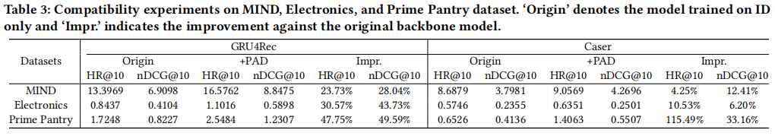
ATAI
Advanced Technique of Artificial Intelligence
ATAI
ChongqingUniversity _{AdvancedTechniqueof}
of Technology Artificial Intelligence
Chongqing University of
Technology
Chongqing University ^{ATAI}
_{of Technology} Advanced Techniqueof
Artificial Intelligence
Chongqing University of Technology
Chongqing University of Technology

Slide 13


ATAI
Advanced Technique of
Artificial Intelligence
ATAI
ChongqingUniversity _{AdvancedTechniqueof}
of Technology Artificial Intelligence
Chongqing University of Technology
Thanks!

